Slide 1
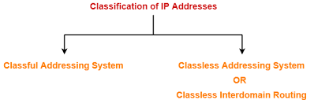
Classful IP representation ( Normal)-
a.b.c.d & Default Subnet Mask for ClassA , Class B, or Class C
1.2.3.4 & 255.0.0.0
128.1.2.3 & 255.255.0.0
192.168.1.20 & 255.255.255.0
Classless IP representation using CIDR Notation-
CIDR IP Addresses look like- a.b.c.d / n
They end with a slash followed by a number called as IP network prefix.
IP network prefix tells the number of bits used for the identification of network.
Remaining bits are used for the identification of hosts in the network.
1.2.3.4/8
128.1.2.3/16
192.168.1.20/24

Slide 2
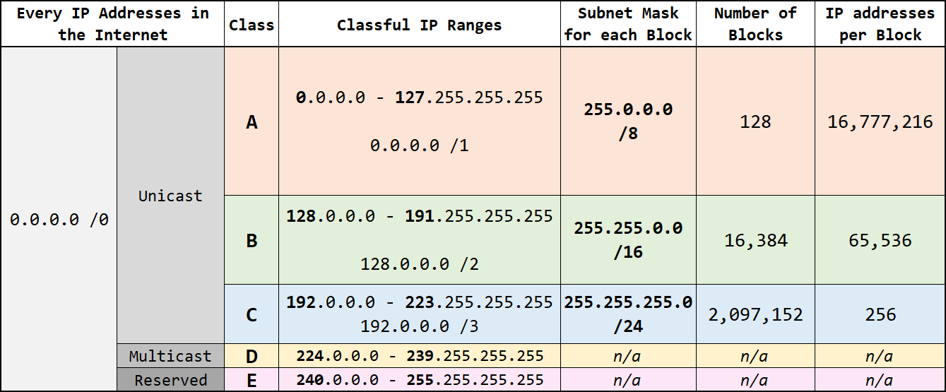
CIDR Representation

Slide 3
Subnetting
The process of dividing a single network into multiple sub networks is called as subnetting.
The sub networks so created are called as subnets.
Advantages -
It improves the security.
The maintenance and administration of subnets is easy.
Disadvantages
Subnetting leads to loss of IP Addresses.
Subnetting leads to complicated communication process.

Slide 4
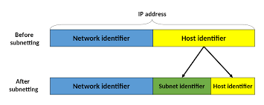
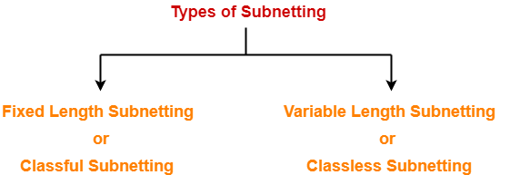
TCP/IP Protocol Suite

Slide 5
Fixed Length Subnetting-
All the subnets are of same size.
All the subnets have equal number of hosts.
All the subnets have same subnet mask.
Variable Length Subnetting-
All the subnets are not of same size.
All the subnets do not have equal number of hosts.
All the subnets do not have same subnet mask.
TCP/IP Protocol Suite

Slide 6
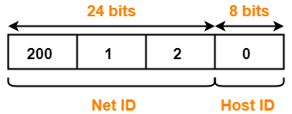
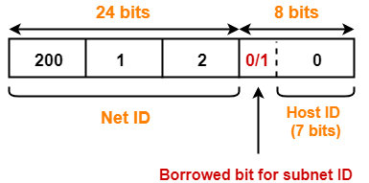
Example-01:
Divide this network 200.1.2.0. in 2 subnets
TCP/IP Protocol Suite

Slide 7
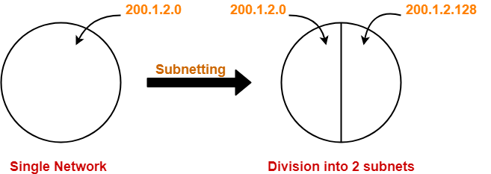
Example-01
TCP/IP Protocol Suite

Slide 8
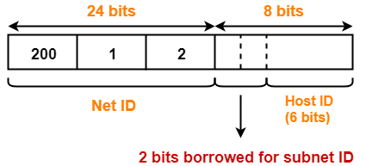
Example – 02: Divide 200.1.2.0 in 4 subnets
TCP/IP Protocol Suite

Slide 9
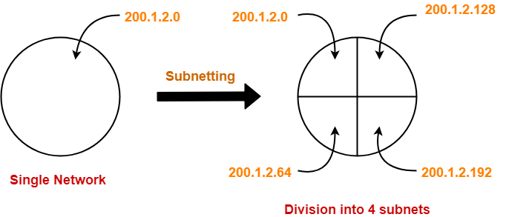
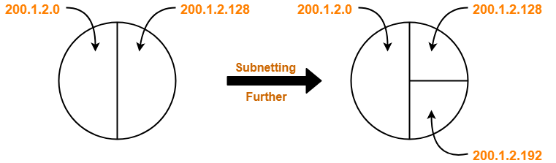
Example – 03: Divide 200.1.2.0 in 3 subnets
TCP/IP Protocol Suite

Slide 10
Conclusion
During subnetting,
We have to face a loss of IP Addresses.
This is because two IP Addresses are wasted for each subnet.
One IP address is wasted for its network address.
Other IP Address is wasted for its direct broadcasting address.
After subnetting, the communication process becomes complex involving the following 4 steps-
Identifying the network
Identifying the sub network
Identifying the host
Identifying the process
TCP/IP Protocol Suite

Slide 11
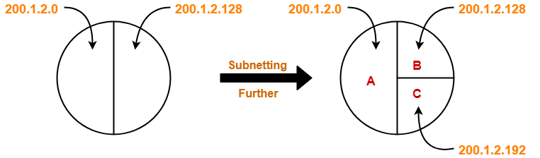
How to Calculate New Subnet Mask?
For any given IP Address, the subnet mask is calculated-
By setting all the bits reserved for network ID part and subnet ID part to 1.
By setting all the bits reserved for host ID part to 0.
Considering Example – 03 Again:
TCP/IP Protocol Suite

Slide 12
For Subnet A-
24 bits identify the global network.
1 bit identify the subnet.
7 bits identify the host.
For subnet A, subnet mask is obtained-
By setting the first 25 bits to 1.
By setting the remaining 7 bits to 0.
So, Subnet mask
= 11111111.11111111.11111111.10000000
= 255.255.255.128 (200.1.2.0 & 255.255.255.128-normal rep) / (200.1.2.0/25 –CIDR rep)
For Subnet B And Subnet C-
For subnet B and subnet C-
24 bits identify the global network.
2 bits identify the subnet.
6 bits identify the host.
For subnet B and subnet C, subnet mask is obtained-
By setting the first 26 bits to 1.
By setting the remaining 6 bits to 0.
So, Subnet mask
= 11111111.11111111.11111111.11000000
= 255.255.255.192 (200.1.2.128/26 ,200.1.2.192/26)
TCP/IP Protocol Suite

Slide 13
Use of Subnet Mask-
Subnet mask is used to determine to which subnet the given IP Address belongs to.
Arrangement Of Subnets-
All the subnets are connected to an internal router.
Internal router is connected to an external router.
The link connecting the internal router with a subnet is called as an interface.
TCP/IP Protocol Suite

Slide 14
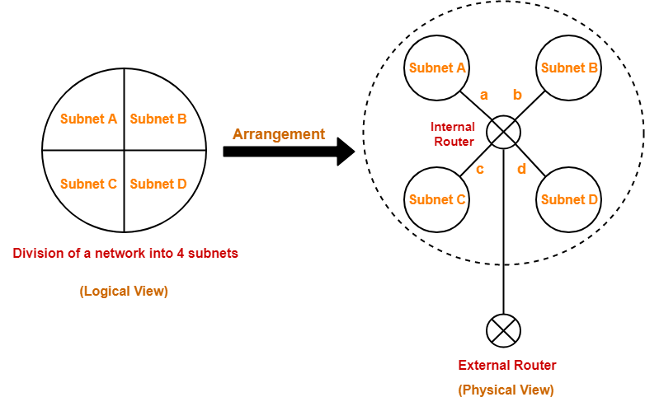
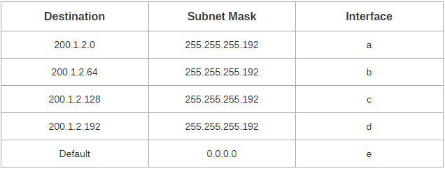
Routing Table of Internal Router
TCP/IP Protocol Suite

Slide 15
Working-
When a data packet arrives,
External router forwards the data packet to the internal router.
Internal router identifies the interface on which it should forward the incoming data packet.
Internal router forwards the data packet on that interface.
Routing Table-
A table is maintained by the internal router called as Routing table.
It helps the internal router to decide on which interface the data packet should be forwarded.
Routing table consists of the following three fields-
IP Address of the destination subnet
Subnet mask of the subnet
Interface
TCP/IP Protocol Suite

Slide 16
When a data packet arrives to the internal router, it follows the following steps-
Step-01:
Router performs the bitwise ANDing of-
Destination IP Address mentioned on the data packet
And all the subnet masks one by one.
Step-02:
Router compares each result with their corresponding IP Address of the destination subnet in the routing table.
Then, following three cases may occur-
Case-01:
If there occurs only one match,
Router forwards the data packet on the corresponding interface.
Case-02:
If there occurs more than one match,
Router forwards the data packet on the interface corresponding to the longest subnet mask.
Case-03:
If there occurs no match,
Router forwards the data packet on the interface corresponding to the default entry.
TCP/IP Protocol Suite

Slide 17
Important Notes-
Note-01:
In fixed length subnetting,
All the subnets have the same subnet mask.
So, bitwise ANDing is performed only once.
If the result matches to any of the destination subnet IP Address,
Router forwards the data packet on its corresponding interface.
Otherwise, it is forwarded on the default interface.
Note-02:
In variable length subnetting,
All the subnets do not have the same subnet mask.
So, bitwise ANDing is performed once with each subnet mask.
Then, the above three cases are followed.
TCP/IP Protocol Suite

Slide 18
Note-03:
A host may also be directly connected to the router.
In that case, there exists a host specific route from the router to the host.
Router saves the IP Address of that host in the “Destination Network” column.
Router saves 255.255.255.255 in the “Subnet Mask” column.
The ANDing of its destination address and subnet mask yields the IP Address of the host.
When a data packet arrives for that specific host, bitwise ANDing is performed.
When the result of ANDing is the IP Address of the host, packet is forwarded to its host specific route.
Note-04:
Subnet mask for default route = 0.0.0.0
Subnet mask for host specific route = 255.255.255.255
TCP/IP Protocol Suite

Slide 19
Subnetting can be done based on either
Number of Subnets Required
Number of Hosts/Subnet Required
TCP/IP Protocol Suite

Slide 20
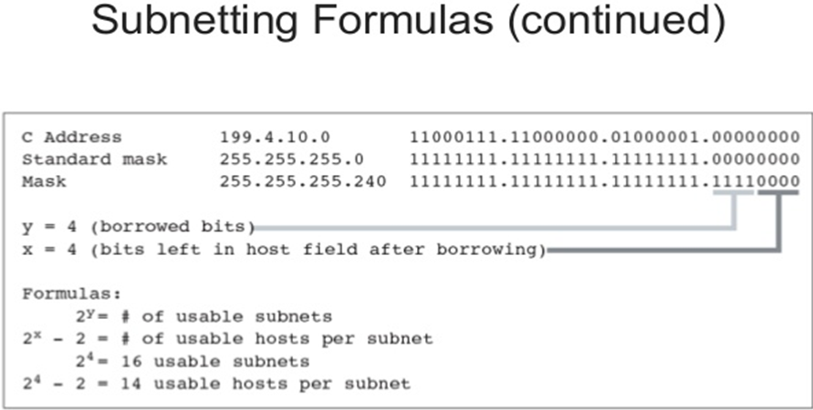
TCP/IP Protocol Suite

Slide 21
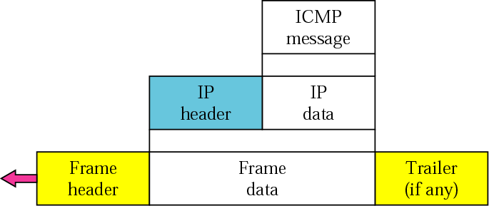
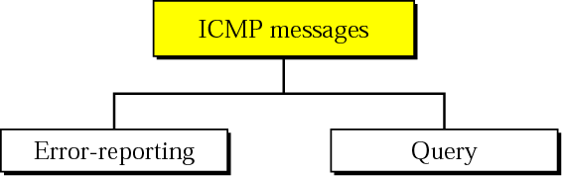
Internet Control Message
Protocol
Figure ICMP encapsulation
Figure ICMP messages
TCP/IP Protocol Suite

Slide 22
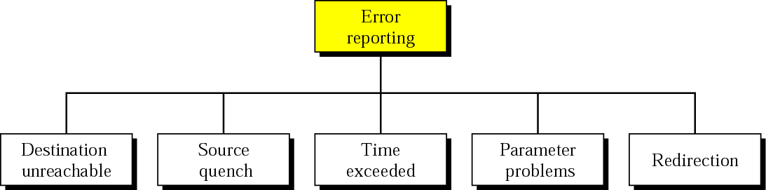
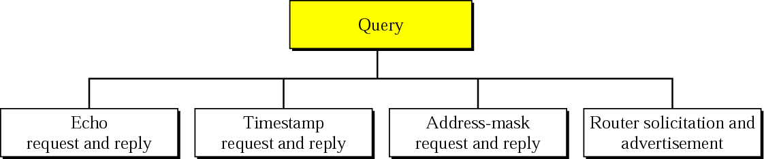
Figure Error-reporting messages
Figure Query messages
TCP/IP Protocol Suite

Slide 23
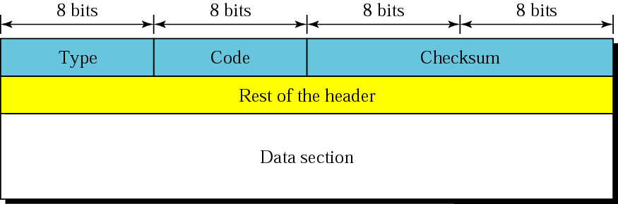
MESSAGE FORMAT
An ICMP message has an 8-byte header and a variable-size data section. Although the general format of the header is different for each message type, the first 4 bytes are common to all.
TCP/IP Protocol Suite

Slide 24
ERROR REPORTING
IP, as an unreliable protocol, is not concerned with error checking and error control.
ICMP was designed, in part, to compensate for this shortcoming.
ICMP does not correct errors, it simply reports them.
ICMP always reports error messages to the original source.
TCP/IP Protocol Suite

Slide 25

Note:
The following are important points about ICMP error messages:
❏ No ICMP error message will be generated in response
to a datagram carrying an ICMP error message.
❏ No ICMP error message will be generated for a
fragmented datagram that is not the first fragment.
❏ No ICMP error message will be generated for a
datagram having a multicast address.
❏ No ICMP error message will be generated for a
datagram having a special address such as 127.0.0.0 or
0.0.0.0.
TCP/IP Protocol Suite

Slide 26
Destination-unreachable messages with codes 2 or 3 can be created only by the destination host.
Other destination-unreachable messages can be created only by routers.
A router cannot detect all problems that prevent the delivery of a packet.
There is no flow-control mechanism in the IP protocol.
A source-quench message informs the source that a datagram has been discarded due to congestion in a router or the destination host.
The source must slow down the sending of datagrams until the congestion is relieved.
TCP/IP Protocol Suite

Slide 27
One source-quench message is sent for each datagram that is discarded due to congestion.
Whenever a router decrements a datagram with a time-to-live value to zero, it discards the datagram and sends a time-exceeded message to the original source.
When the final destination does not receive all of the fragments in a set time, it discards the received fragments and sends a time-exceeded message to the original source.
In a time-exceeded message, code 0 is used only by routers to show that the value of the time-to-live field is zero. Code 1 is used only by the destination host to show that not all of the fragments have arrived within a set time.
A parameter-problem message can be created by a router or the destination host.
TCP/IP Protocol Suite

Slide 28
A host usually starts with a small routing table that is gradually augmented and updated. One of the tools to accomplish this is the redirection message.
A redirection message is sent from a router to a host on the same local network.
TCP/IP Protocol Suite

Slide 29
QUERY
ICMP can also diagnose some network problems through the query messages, a group of four different pairs of messages.
In this type of ICMP message, a node sends a message that is answered in a specific format by the destination node.
TCP/IP Protocol Suite

Slide 30
An echo-request message can be sent by a host or router. An echo-reply message is sent by the host or router which receives an echo-request message.
Echo-request and echo-reply messages can be used by network managers to check the operation of the IP protocol.
Echo-request and echo-reply messages can test the reachability of a host. This is usually done by invoking the ping command.
Timestamp-request and timestamp-reply messages can be used to calculate the round-trip time between a source and a destination machine even if their clocks are not synchronized.
The timestamp-request and timestamp-reply messages can be used to synchronize two clocks in two machines if the exact one-way time duration is known.
TCP/IP Protocol Suite

Slide 31
CHECKSUM
In ICMP the checksum is calculated over the entire message (header and data).
TCP/IP Protocol Suite

Slide 32
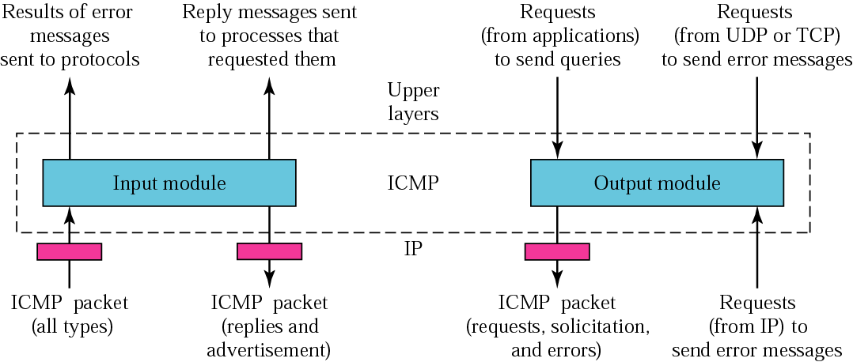
Figure ICMP package
TCP/IP Protocol Suite

